Slide 1
Smart Plant Health Monitor
Edge-to-Cloud IoT System with ML Capabilities
By: Moyata Ebisso

Slide 2
The Problems With Plant Care:
40% of houseplants die from improper watering
People forget to water or overwater their plants
No easy way to know when a plant actually needs attention
Traditional solutions require constant manual checking

Slide 3
The Solution: Smart Monitoring
Automated sensing of soil moisture, temperature, humidity
Edge intelligence makes local decisions without cloud dependency
Alerts when plant needs water (buzzer + visual)
Cloud dashboard (Thingspeak + Ubidots) for historical trends and remote monitoring
Camera capture documents plant health over time

Slide 4
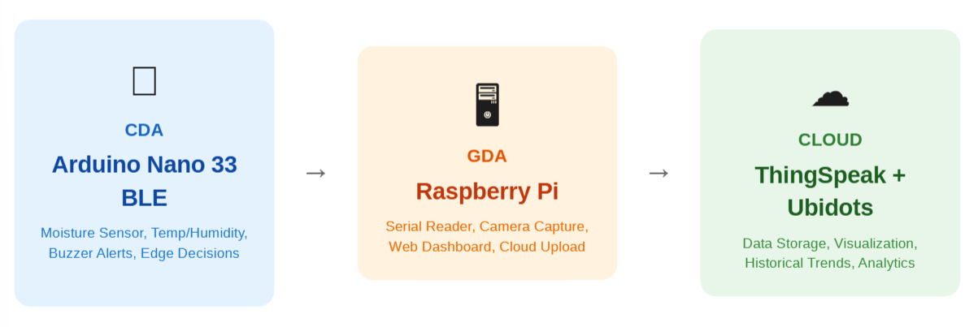
System Architecture
CDA-GDA-Cloud Architecture

Slide 5
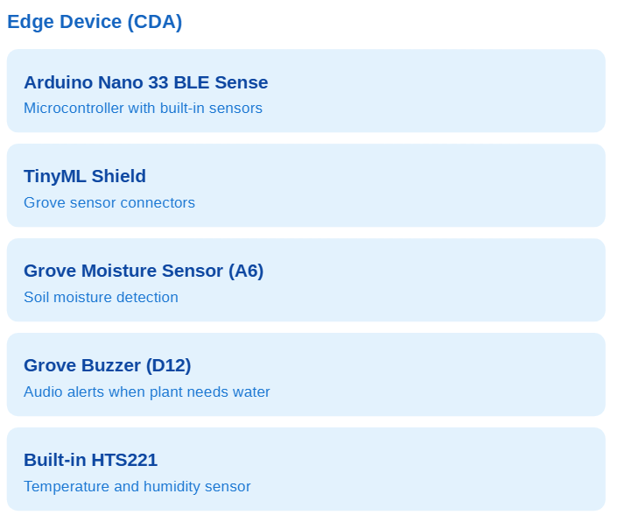
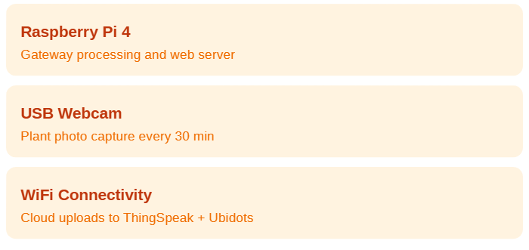
Hardware Components
Edge Device (CDA):
Gateway Device (GDA):

Slide 6
Data Flow Pipeline
Sense
Edge Decision
Transmit
Gateway Process
Cloud Upload
Arduino reads moisture, temp, humidity every 5 seconds
Arduino determines status locally:
If (moisture < 30%) :
NEEDSWATER
BUZZER
JSON via USB Serial:
{“temp”:22.0, “humidity”:50.0,”moisture”:44,”status”:”HEALTHY”}
Pi receives, logs to CSV, captures photo if problem detected
HTTP POST to ThingSpeak (15s) + Ubidots (10s) for visualization

Slide 7
Edge Intelligence
Why Edge Processing Matters:
What Runs on the Edge (Arduino):
Sensor reading and calibration
Works Offline - No internet needed for alerts
Threshold decision (moisture < 30% = alert)
Low Latency - Instant Response, no cloud trip
Immediate buzzer alerts (milliseconds)
Reduced Bandwidth
Status determination before sending
Privacy - Data processed locally

Slide 8
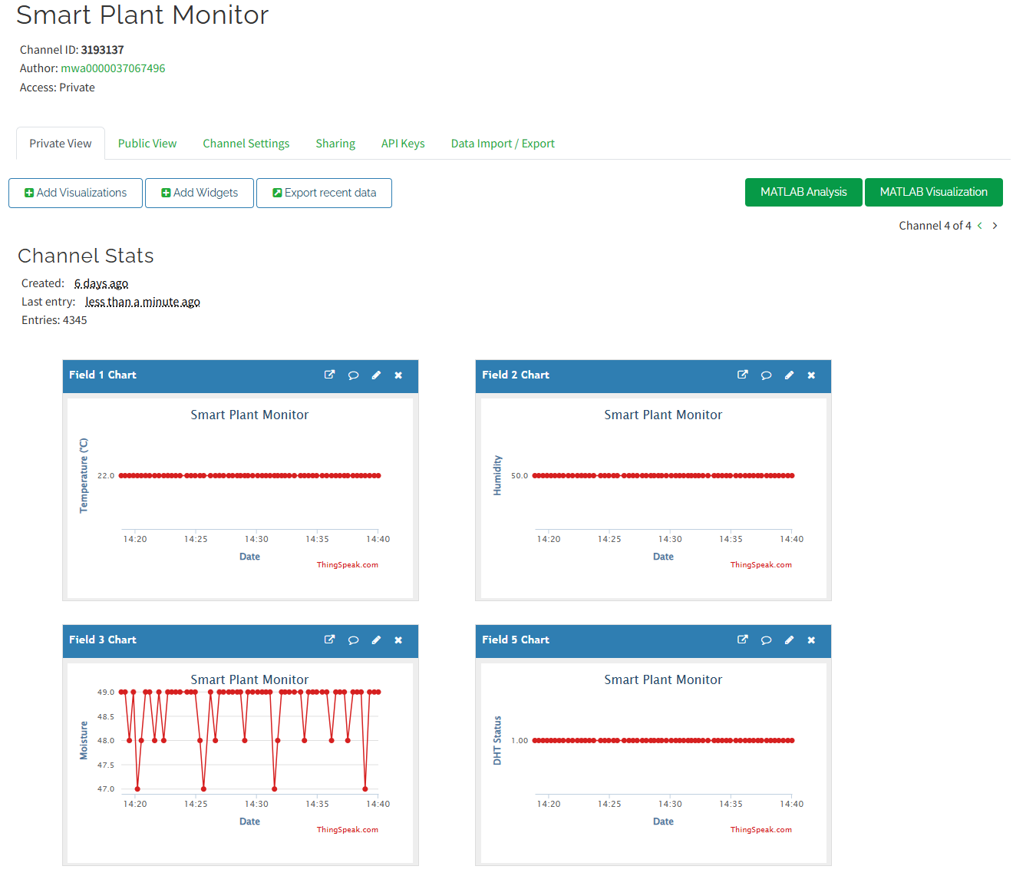
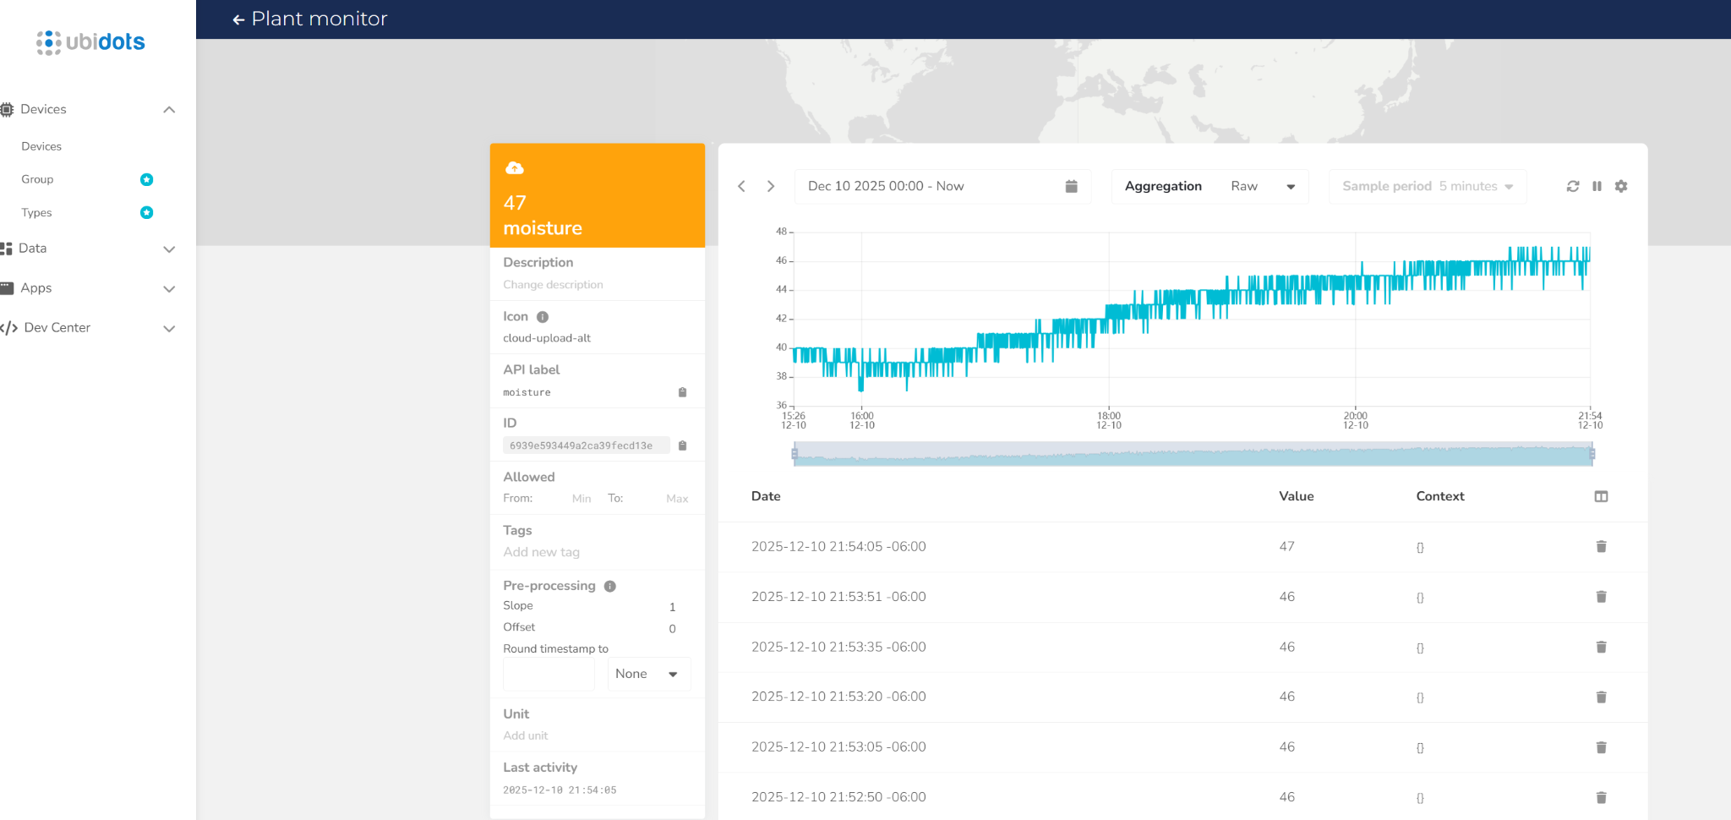
Cloud Dashboards
ThingSpeak
UbiDots
Smart Plant Monitor - ThingSpeak IoT
Ubidots | Devices

Slide 9
Challenges and Solutions
Windows USB Failed
Bypassed Windows
Device Descriptor Request Failed on all 5 cables
Connected Arduino directly to Raspberry Pi
Moisture Sensor Inverted
Swapped Calibration
Adding water decreased the readings
Exchanged MOISTURE_DRY and MOISTURE_WET values
Temp + Humidity Sensor Not Initializing
Fallback Values
Temperature sensor failed to start
System continues with default values (22C, 50%)

Slide 10
Live Demo
ssh plant-pi@10.50.200.183
cd /plant-monitor
pkill -f gateway_direct.py; sleep 2; cd ~/plant-monitor && python3 gateway_direct.py
or
sudo kill $(sudo lsof -t -i:5000) 2>/dev/null
Smart Plant Monitor - ThingSpeak IoT
Ubidots | Devices

Slide 11
Future Enhancements
Phase 1: Edge Impulse ML
Phase 2: Auto Watering
Phase 3: Multi-Plant
Phase 4: Mobile App
Train image classification model to detect healthy, wilting and diseased plants.
Edge Impulse Link: Plant Health Monitor - Dashboard - Edge Impulse
Add water pump and relay for automatic irrigation when soil is dry. Include safeguards to prevent overwatering.
Multiple sensor nodes with unified dashboard showing all plants. Individual care profiles per plant type.
Push notifications for alerts, remote photo viewing, and historical analytics on your phone.

Slide 12
Conclusion
Complete CDA-GDA-Cloud architecture
Edge computing with local decisions
Dual cloud integration (ThingSpeak + Ubidots)
Embedded systems (Arduino C++)
Python gateway development
IoT protocols (Serial, HTTP, JSON)
Cloud service integration
System debugging & troubleshooting
Camera documentation system
Web dashboard + real-time alerts

Slide 13
Thank you
Questions?
Github: moyataebisso/smart-plant-monitor

